Slide 1
Data Modelling, Management & Governance CIS108-6
Introduction of NoSQL database
Gangmin Li

Slide 2
Learning Objectives and outline
Understand the basic of NoSQL
Four major types of NoSQL Database
Motivation
CAP Theorem
Category
Typical NoSQL API

Slide 3
1. Why NoSQL?
Data world comes in two major types
Structured
Unstructured

Slide 4
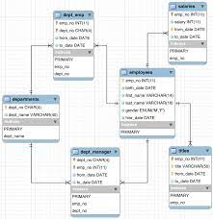
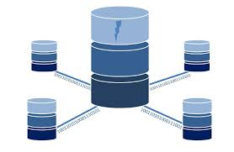
RDBMS issues
Structured data. RDBMS assumes a well-defined structure of data and assumes that the data is largely uniform. However, the reality is that many data are or semi-structured or not structured.
Fixed schemas. The schemas and its properties including columns, types and length etc. must be defined before building the application. This does not match well with the agile development approaches for highly dynamic applications.
Complicated query. RDAMS use SQL, which is declarative and powerful language can do many complicated operations such as join but may be overkill.
Notes:
Web and large enterprises applications often need to support tens of thousands of users simultaneously. Some of the most important features of relational databases become hurdles for the development of applications, such as ensuring anyone reading data will have a consistent view of the data, require time, storage, and computational resources. The relational databases are not always meeting the needs and facing serious of challenges because its properties:
Structured data. RDBMS assumes a well-defined structure of data and assumes that the data is largely uniform. However the reality is that many data are or semi-structured or not structured.
Fixed schemas. The schemas and its properties including columns, types and length etc. must be defined before building the application. This does not match well with the agile development approaches for highly dynamic applications.
Complicated query. RDAMS use SQL, which is declarative and powerful language can do many complicated operations such as join but may be overkill.
Scalability. As the data starts to grow larger, you have to scale your database vertically, which means adding more capacity to the existing servers. Relational databases may not scale sufficiently to handle high data and query loads or this scalability comes with a very high cost.

Slide 5
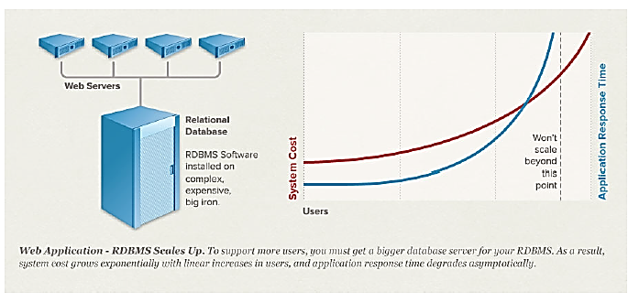
RDBMS’ Scalability (up)
As the data starts to grow larger, you have to scale your database
RDBMS Scales up by adding more hardware capacity. (scale vertically)
At certain point relational database won't scale

Slide 6
Scalability cost for big data
Relational databases may not scale sufficiently to handle big data and query loads or this scalability comes with a very high cost.
URL | UserID | TimeStamp | AdditionInformation
/book/a0ip2 | a0001 | 13:07:13/12/2014 | 1
/book/blk01 | a0002 | 18:10:13/12/2014 | 4
… 25,000,000 more record | … | … | …
/book/ppi09 | a0001 | 09:12:24/12/2015 | 3
Task: Find all records for… Given UserID, Given URL, Given timestamp
Assuming each record scan cost = 0.1 ms = 0.0001 s
25,000,000 * 0.0001s = 2500s = 42 minutes

Slide 7
Think about age group
Log table: URL, UserID, timestamp, additional-info
User table: UserID, name, age, gender, …
Task: Find average age of user accessing and given URL
SELECT AVG(User.age) FROM Log, User WHERE Log.URL = ‘/book/blk01’ and Log.UserID = User.UserID
Scan first table to get a list of UserID that matches the given URL and link the UserID list to the second table.
Scan the second table that the same list of UserID for age and counting the average Age
If there are 1000 user visited the URL
The time to get all the age of the 1000 user need to scan 1000 times of the second table that
will be 42*1000 = 42000 minutes =700 hours = 29 days
Final time cost = 29 days + 42 minutes
Notes:
Atomicity - pronounced "atom-miss-city". By "atomic" we mean "as a single atom or unit". This is a method of grouping data together as single unit so that the atomic unit of data is either entered into the database or not. It's either "All or nothing" as partially updating a record in the database can have bad results in real-life. Imagine you deposit $1M dollars into your bank account but the deposit transaction only updated the database with your account number but not the deposit amount. You would be very unhappy if you deposited $1M but the database transaction to record that failed before increasing your balance. If you were the bank teller who was using the software application that allows for entering a check deposit, you need instant application feedback about the success or failure when you hit submit after entering such things as the account number and deposit amount. The teller needs confirmation that the transaction was entire transaction completed successfully or failed completely and nothing about that deposit was added to the database. When failure happens for any reason because the transaction was an all or nothing the teller is free to attempt the transaction again without fear that he or she is adding a second $1M deposit.
Consistency - can be thought of as... will an update to a database record field leave the database in a good or consistent state? Imagine if you designed your US customer database to store a customer's phone number. Here in the US, we use a 10 digit phone number that consists of a 3 digit area code followed by a 3 digit local prefix and a 4 digit number to uniquely identify a phone endpoint in that locality. For example (605-475-6968). Imagine if a request to create a record with only a four digit number, 6968, came into the database. This erroneous piece of data would leave that particular record in a logically in-consistent or corrupted state.
Isolation - Because databases allow multiple updates to be occurring at the same time, each transaction must be isolated from the others to prevent unwanted side-effects of transactions "stepping" on one another. An example of when this can be tricky is if a database were to delete a record and before the associate index could be removed, a second transaction to find records matching a certain criteria found the index for that record and went to retrieve the record that was just deleted. This would cause an error because the two transactions stepped on one another in time.
Durability - Once a transaction is stored in the database it must be durable in the sense of it will exist even in the face of a computer power outage (reboot). Modern databases often store the received data in RAM due to it's speed matches that of the CPU. However, RAM is volatile if power is lost. To be durable the transaction is often written to a database log file before being acknowledged as "written" back to the application which asked to store data.

Slide 8
Example : Social-network graph
Deadlock issue
Friends Tables: UserID₁, UserID₂
User records: UserID, name, age, gender, etc.
Task: Find all friends of friends of friends of … friends of given user

Slide 9
The four big issues with RDBMS
Structured data
Fix schema
Complicated query (join multiple tables)
Scalability

Slide 10
What is NoSQL?
Definition (from official Wikipedia): A NoSQL (originally referring to "non SQL", "non relational" or "not only SQL") database provides a mechanism for storage and retrieval of data which is modeled in means other than the tabular relations used in relational databases management systems (RDBMS).
No fixed schema (formally described structure)
Does not use SQL as querying language
No joins (which is typical in RDBMS operated with SQL)
Expensive operation for combining records from two or more tables into one set
Joins require strong consistency and fixed schemas
Not deployed on a single node or server. It is Distributed, fault-tolerant architecture
It's not a replacement for a RDBMS but compliments it

Slide 11
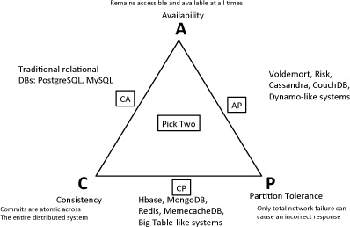
2. CAP Principle (Theorem)

Slide 12
ACID Rules RDBMS
Atomic: A transaction is a logical unit of work which must be either completed with all of its data modifications, or none of them is performed.
Consistent: At the end of the transaction, all data must be left in a consistent state.
Isolated: Modifications of data performed by a transaction must be independent of another transaction. Unless this happens, the outcome of a transaction may be erroneous.
Durable: When the transaction is completed, effects of the modifications performed by the transaction must be permanent in the system.

Slide 13
BASE Rule - NoSQL
Basically Available indicates that the system does guarantee availability, in terms of the CAP theorem.
Soft state indicates that the state of the system may change over time, even without input. This is because of the eventual consistency model.
Eventual consistency indicates that the system will become consistent over time, given that the system doesn't receive input during that time.

Slide 14
Partition-tolerance
https://www.sciencedirect.com/topics/computer-science/partition-tolerance
A given system continues to operate even with data loss or system failure. A single node failure should not cause the entire system to collapse.
Ability of two segments of the system (partitions) to proceed in the presence of a temporary communication failure in their network. With more partition tolerance, the database is more available to clients, but the accessible data is less consistent and vice versa.

Slide 15
Comparison

Slide 16
NoSQL Summary
To address the issues and difficulties of RDBMS different versions of NoSQL database management
Flexible schema
Massive scalability
Relaxed consistency → fewer guarantees → higher performance & availability
Systems are developed and mostly by enterprises that hold and produce big data, e.g. Google, Facebook and twitter.

Slide 17
More Programming and Less Database Design
NoSQL Summary
Alternative to traditional relational DBMS
It's not a replacement for a RDBMS but compliments it!

Slide 18
3. Types of NoSQL Databases
There are four types of NoSQL databases:
Key-Value Pairs
Document-oriented NoSQL database
Column based database
Graph based database

Slide 19
Key-value Pair

Slide 20
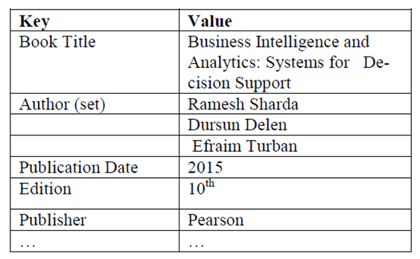
Key/Value Databases
The key of a key/value pair is a unique value in the set and can be easily looked up to access the data. Key/value pairs are of varied types: some keep the data in memory, and some provide the capability to persist the data to disk.
Examples: Oracle’s Berkeley DB,
Redis, Amazon SimpleDB, etc

Slide 21
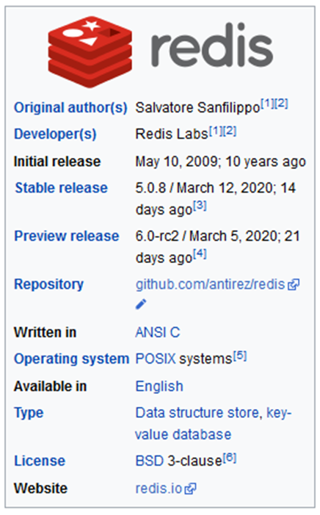
Redis
Extremely simple interface
Data model: key/value pairs
Operations:
Insert(key, value), Fetch(key), Update(key), Delete(key)
Implementation: efficiency, scalability, fault-tolerance
Records distributed to nodes based on key
Replication
Single-record transactions, eventual consistency

Slide 22
Amazon SimpleDB
Store and query data items via web services
Based on Amazon’s Single Storage Service (S3)
items (represent objects) having one or more pairs (name, value), where name denotes an attribute.
An attribute can have multiple values.
items are combined into domains.
high availability and flexibility
Geo-redundantly replicates
Add new attribute to data set when needed
Choose between consistent or eventually consistent read requests

Slide 23
Online Games
Common data online games can store, index, and query with Amazon SimpleDB includes:
User scores and achievements
User settings or preferences
Information about a player’s items or user-generated content
Game session state (when play is saved or interrupted)
Dynamic game content (applying a service-oriented architecture to your game and storing and serving new challenges or content for players with Amazon SimpleDB)
Indexed metadata for large objects used by your game and stored in Amazon S3

Slide 24


Shopping Cart Data
As we want the shopping carts to be available all the time, across browsers, machines, and sessions, all the shopping information can be put into value where the key is the userID

Slide 25
Document-oriented NoSQL

Slide 26
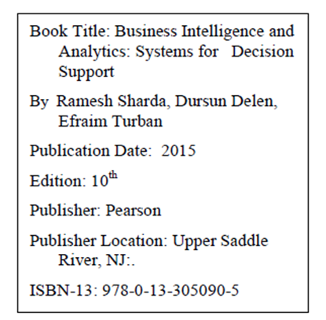
Document-oriented NoSQL
A Document-oriented NoSQL Database has a similar structure to an XML document which is hierarchical.
It provides high availability, high performance and easy scalability.
Examples: MongoDB, CouchDB

Slide 27
MongoDB
MongoDB organize data on concept of collections of document, which made up by different fields. Let us see these definitions.

Slide 28
Example of a document
{ _id: ObjectID('4bd9e8e17cefd644108961bb'),
title: 'Adventures in Databases',
url: 'http://example.com/databases.txt',
author: 'msmith',
vote_count: 20,
tags:['databases', 'mongodb', 'indexing'],
image:{
url: 'http://example.com/db.jpg',
caption: '',
type: 'jpg',
size: 75381,
data: "Binary"
},
comments: [
{ user: 'bjones',
text: 'Interesting article!'
},
{ user: 'blogger',
text: 'Another related article is at http://example.com/db.txt'
}
]
}

Slide 29
MongoDB Data Model
Data in MongoDB has a flexible schema.
Documents in the same collection do not need to have the same set of fields or structure,
common fields in a collection’s documents may hold different types of data.
Data modeling on the conceptual level (CDM) and the logical data model (LDM) is very similar to what is done for a RDBMS
When the data model is transformed from the LDM to a physical data model (PDM) by either embedding data or referencing documents
MongoDB does not support Join.

Slide 30
MongoDB data representation
MongoDB uses BSON data representation for data storage and network transfer.
BSON is short for binary JSON. We can write JSON
{
"firstname": "John",
"lastname": "Smith",
"phone_numbers": [
"+44 1122 3456",
"+44 1234 565 555"
]
}
{
"firstname": "John",
"lastname": "Smith",
"numbers": [
{
"phone": "+44 1122 3456"},
{
"Moble": "+44 1234 565 555"}
]
}

Slide 31
MongoDB CRUD operations
CRUD stands for create, read, update, and delete
Create, update and delete are generally regarded as write operations. A write operation modifies data stored in the database instance.
Read is the most important operation for a database. It is also called query which retrieves data in the database.
MongoDB can be used to analysis big data through Aggregation framework or pipeline;

Slide 32
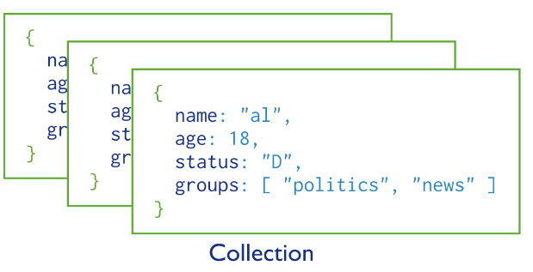
A collection of MongoDB documents

Slide 33
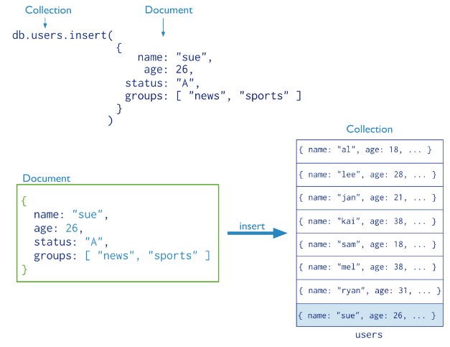
Insert Operation

Slide 34
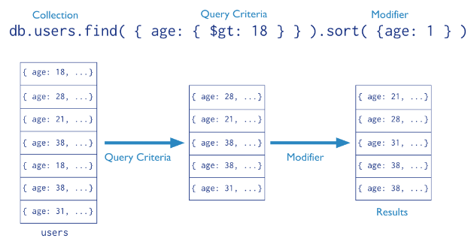
Query Opeation

Slide 35
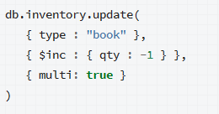
Update Operation

Slide 36
Delete Operation
db.inventory.remove()
db.inventory.remove( { type : "food“ } )
Try
https://www.mongodb.com/
http://try.mongodb.org/

Slide 37
Suitable Use Cases
Event Logging
Content Management Systems
Web Analytics or Real time Analysis
E-commerce Applications

Slide 38
Column-based Databases

Slide 39
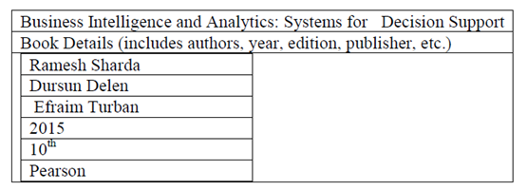
Column Based Databases
The column-oriented database is very similar to RDBMS. Although RDBMS tend to have simple data types and a predefined schema, Column based NoSQL databases provide much more flexibility which allows data to be stored effectively.
Cassandra, Membase, Redis, MemcacheDB
Notes:
It avoids consuming space when storing nulls by simply not storing a column when a value doesn’t exist for that column. Each unit of data can be thought of as a set of key/value pairs, where the unit itself is identified with the help of a primary identifier,

Slide 40
Column-based
Allow key-value pairs to be stored (and retrieved on key) in a massively parallel system
data model: families of attributes defined in a schema
new attributes can be added
storing principle: big hashed distributed tables
properties: partitioning (horizontally and/or vertically), high availability etc. completely transparent to application

Slide 41
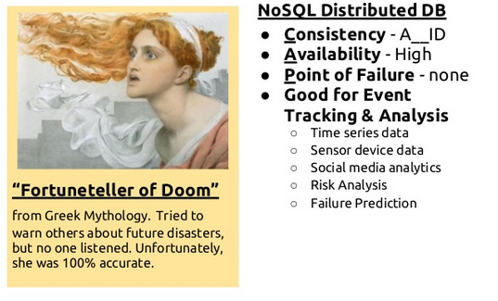
Cassandra
https://cassandra.apache.org/_/index.html

Slide 42
Cassandra
keyspace: Usually the name of the application; e.g., 'Twitter', 'Wordpress‘.
column family: structure containing an unlimited number of rows
column: a tuple with name, value and time stamp
key: name of record
super column: contains more columns

Slide 43
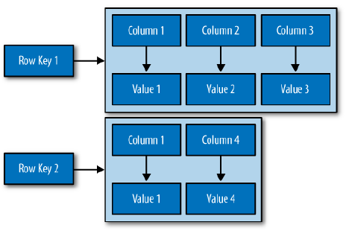
Column Family

Slide 44
Example
ID Last First Bonus
1 Doe John 8000
2 Smith Jane 4000
3 Beck Sam 1000
Cassandra would store the above data as,
"Bonuses" : {
row1 : { "ID":1, "Last":"Doe", "First":"John", "Bonus":8000},
row2 : { "ID":2, "Last":"Smith", "First":"Jane", "Bonus":4000}
...
}

Slide 45
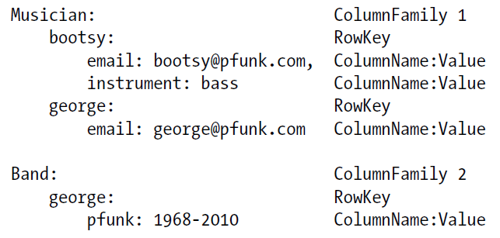
Example

Slide 46
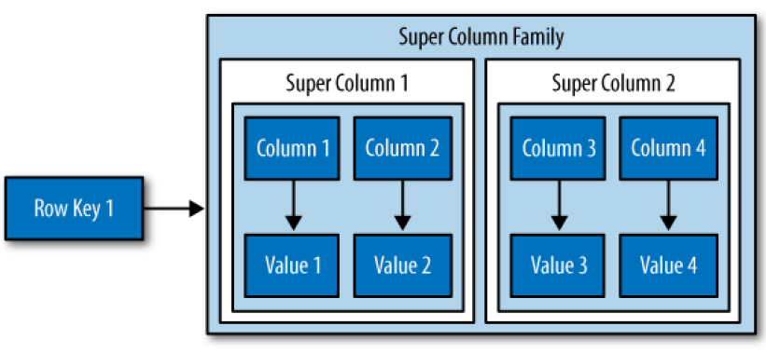
Super Column Family

Slide 47
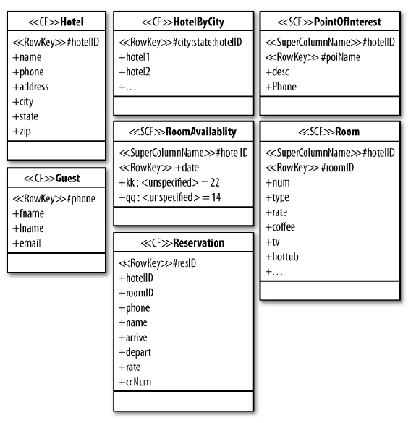
Cassandra

Slide 48
Suitable Use Cases
Event Logging
Content management Systems, blogging platforms

Slide 49
Graph-based Databases

Slide 50
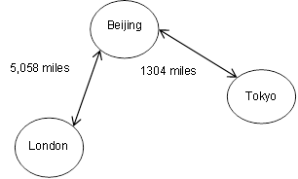
Graph Based Databases
A graph database uses graph structures with nodes, edges, and properties to represent and store data。
Examples: Neo4j, OrientDB, Google Knowledge graph, Facebook Open Graph, FlockDB
Notes:
.By definition, a graph database is any storage system that provides index-free adjacency. This means that every element contains a direct pointer to its adjacent element and no index lookups are necessary. General graph databases that can store any graph are distinct from specialized graph databases such as triple-stores and network databases. Indexes are used for traversing the graph. Popular graph based NoSQL databases include Neo4j, OrientDB, Facebook Open Graph, FlockDB, etc. Figure 7.3 is an example of a graph database for the distance between three major cities.

Slide 51
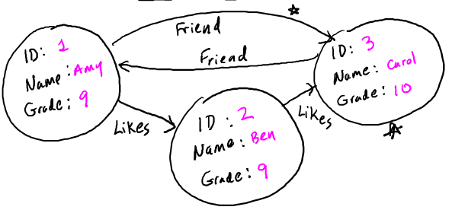
Graph Database
Data model: nodes and edges
Nodes may have properties (including ID)
Edges may have labels or roles

Slide 52
Graph Database Systems
Interfaces and query languages vary
Single-step versus “path expressions” versus full recursion
Neo4j is the most popular graph DB
New Intro:
https://www.youtube.com/watch?v=urO5FyP9PoI&t=11s
(119) Better Data, Better Decisions – 1000x Faster with Neo4j. – YouTube

Slide 53
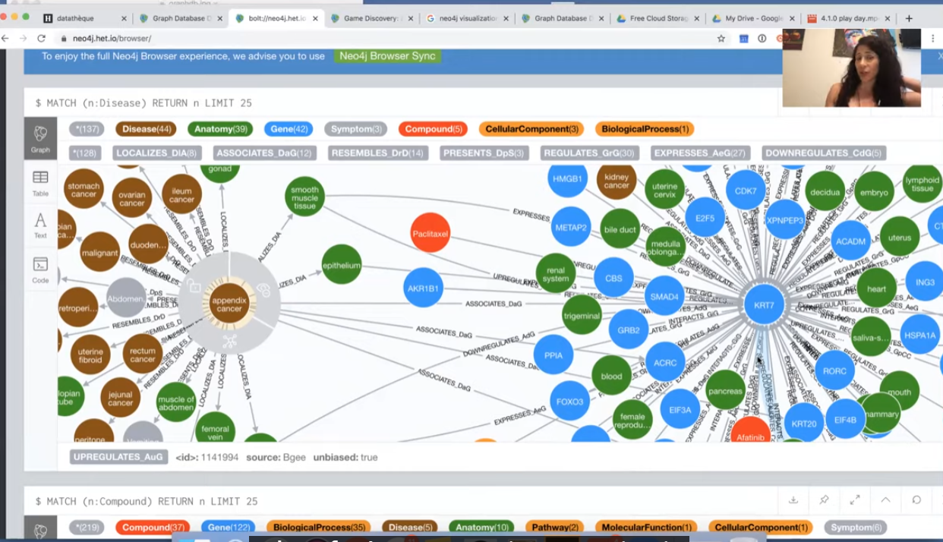
Cypher
https://www.youtube.com/watch?v=REVkXVxvMQE

Slide 54
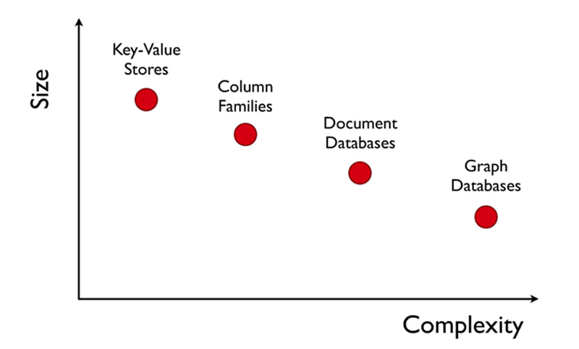
Comparing

Slide 55
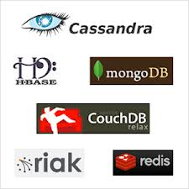
Challenge: Coordination
The solution to availability and scalability is to decentralize and replicate functions and data…but how do we coordinate the nodes?
data consistency
update propagation
mutual exclusion
consistent global states
group membership
group communication
event ordering
distributed consensus
quorum consensus

Slide 56
Summary
NoSQL database cover only a part of data-intensive cloud applications (mainly Web applications).
Problems with cloud computing:
SaaS applications require enterprise-level functionality, including ACID transactions, security, and other features associated with commercial RDBMS technology, i.e. NoSQL should not be the only option in the cloud.
Hybrid solutions:
Voldemort with MySQL as one of storage backend
deal with NoSQL data as semistructured data
⇒ integrating RDBMS and NoSQL via SQL/XML

Slide 57
Summary
Next generation of highly scalable and elastic RDBMS: NewSQL databases (from April 2011)
they are designed to scale out horizontally on shared nothing machines,
still provide ACID guarantees,
applications interact with the database primarily using SQL,
the system employs a lock-free concurrency control scheme to avoid user shut down,
the system provides higher performance than available from the traditional systems.
Examples: MySQL Cluster (most mature solution), VoltDB, Clustrix, ScalArc, …

Slide 58
Summary
New buzzword: SPRAIN – 6 key factors for alternative data management:
Scalability
Performance
relaxed consistency
Agility

Slide 59
Reference
A Little Riak book http://littleriakbook.com/
https://www.mongodb.org/
http://cassandra.apache.org/
http://nosql-database.org/
Neo4j

